Slide 1
Dating Mining Final Project
Giancarlo Ayllon, Chris Bernal, Alex Chavez, Ashlyn Sam, Jonathan Wallace

Slide 2
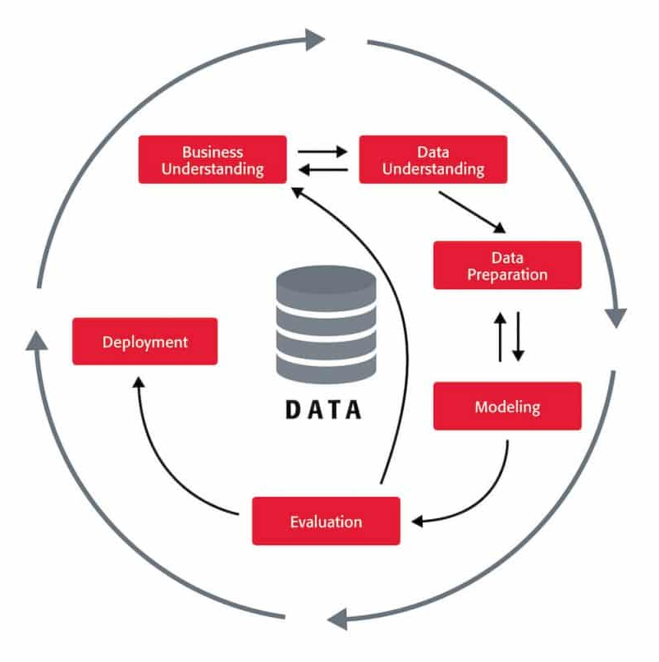
Data Mining Life Cycle
CRISP-DM Standard
systematic approach to data mining
worked our project through the cycle
6 stages:
business understanding, data understanding, data preparation, modeling, evaluation, and deployment

Slide 3

Project Topic
YouTube
second most popular search engine and second most popular social media platform
traffics 2.7 billion users per month
highest earning content creator made $85 million (2023)
Notes:
Because of this, it allows youtube creators to be able to make a living solely off this platform.

Slide 4
Objectives
Using data mining concepts and techniques...
Is it possible to forecast YouTube success rate strategies?
Is there a correlation between upload frequency to video views and subscribers?

Slide 5
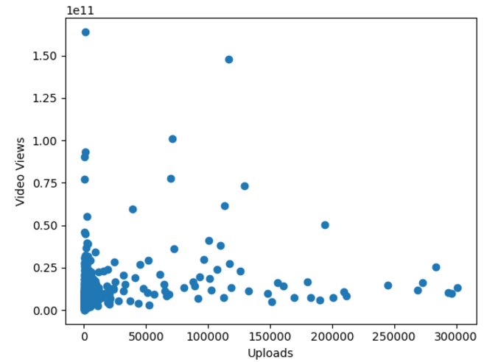
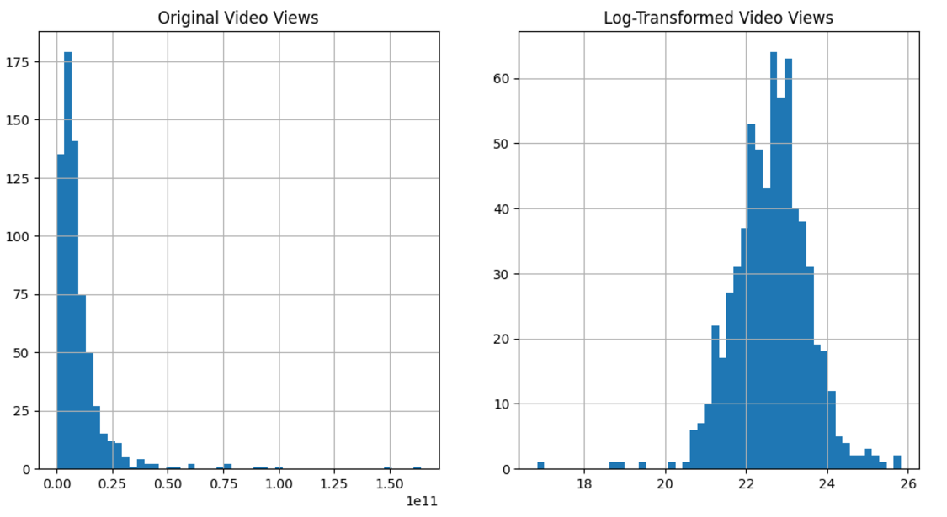
Methodologies – Data Preparation
data was originally skewed
used log to normalize the data
used bar charts, scatter plots, and interquartile checks

Slide 6
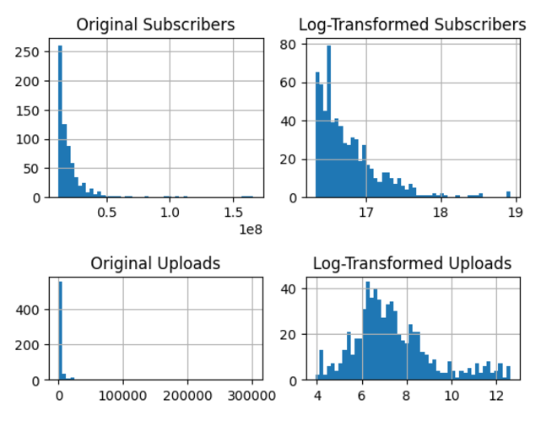
Methodologies – Data Preparation

Slide 7
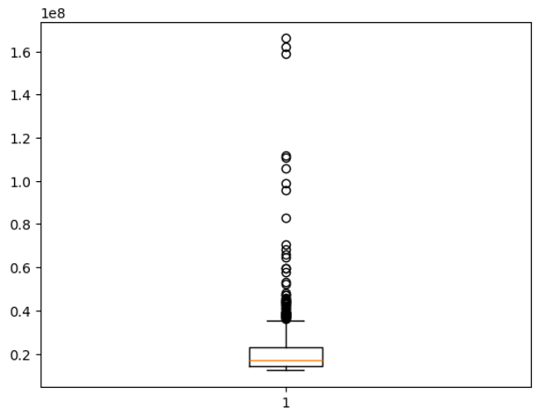
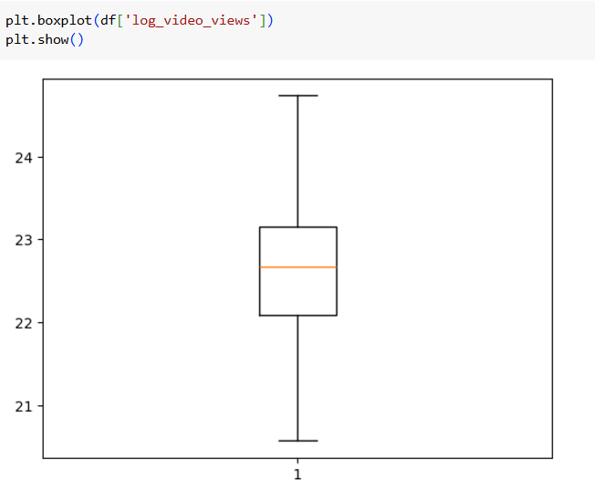
Methodologies – Data Preparation
identify missing data and remove outliers
outliers included viral videos, channels with 0 subscribers, music channels, etc.
upper and lower bound were important for outlier identification
used box plot to visually show that the outliers have been removed from the dataset

Slide 8
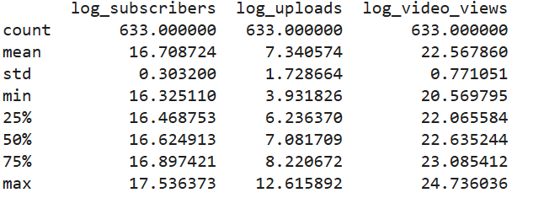
Methodologies – Data Exploration
Descriptive Statistics:
high SD in uploads but lower SD's in video views and subscribers. Shows how we did not remove outliers in uploads.
upload has a high range (~8.7) compared to views (~4.15) and subscribers (~1.17).
the compactness of the middle percentiles show how we have created a normal distribution.

Slide 9
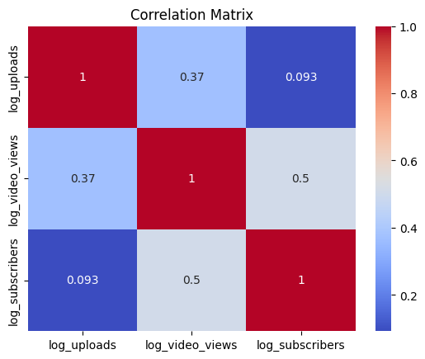

Methodologies – Data Exploration
Correlation Heat Map
visual representation of the correlation between multiple variables
in our case, this shows the correlation between uploads, video views, and subscribers.
the numbers:
uploads and subscribers: 0.093
uploads and video views: 0.37
video views and subscribers: 0.5

Slide 10
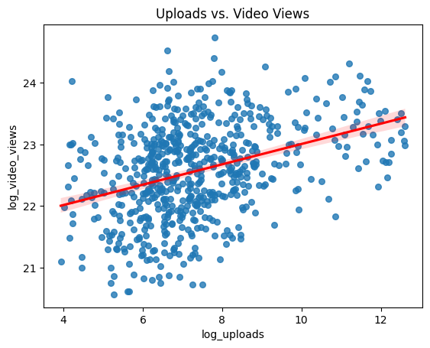
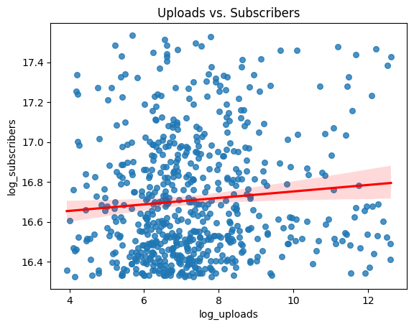
Methodologies – Data Exploration
Supporting Scatter Plots
the scatter plots represent a channel's video views and uploads pair.
red line is a best-fit line that shows where the relationship strength and direction lies.
correlation matrix numbers:
0.37
0.093
positive, but weak in both.

Slide 11
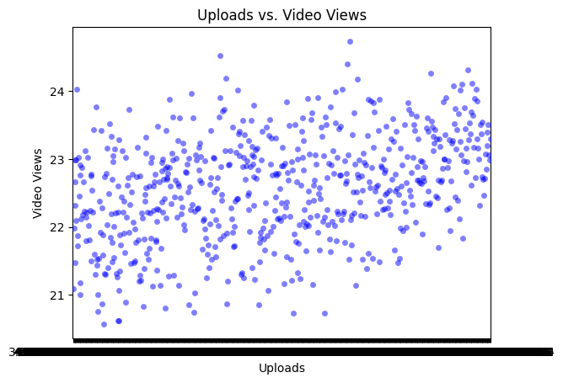
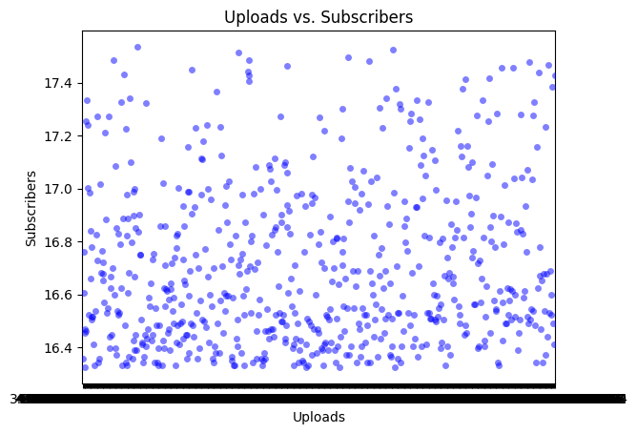
Methodologies – Data Exploration
Bee Swarm Plots
The bee swarm plots help show data density and potential trends. Makes it easier to see clusters.
Uploads vs. Video Views
A weak but noticeable positive trend is noticeable.
The density of the points is fairly constant following this trend.
Uploads vs. Subscribers
No trend is noticeable.
High density towards the bottom half of subscribers.

Slide 12
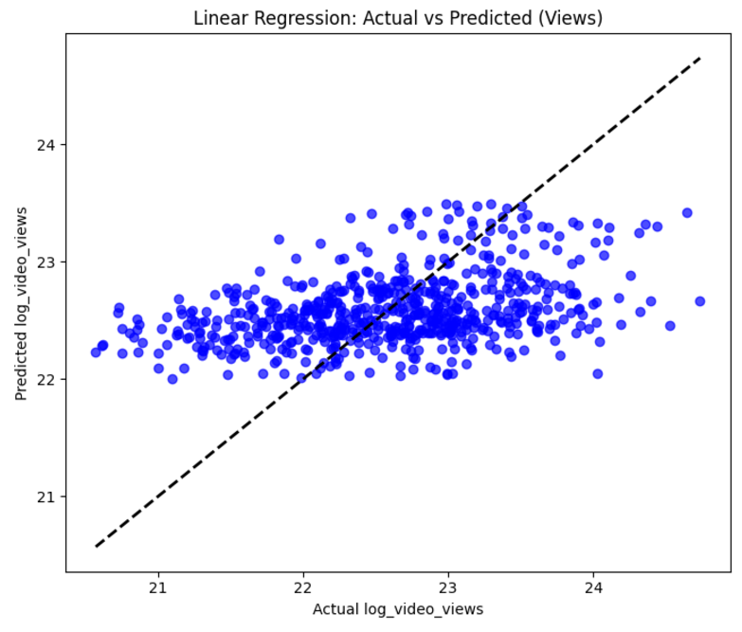
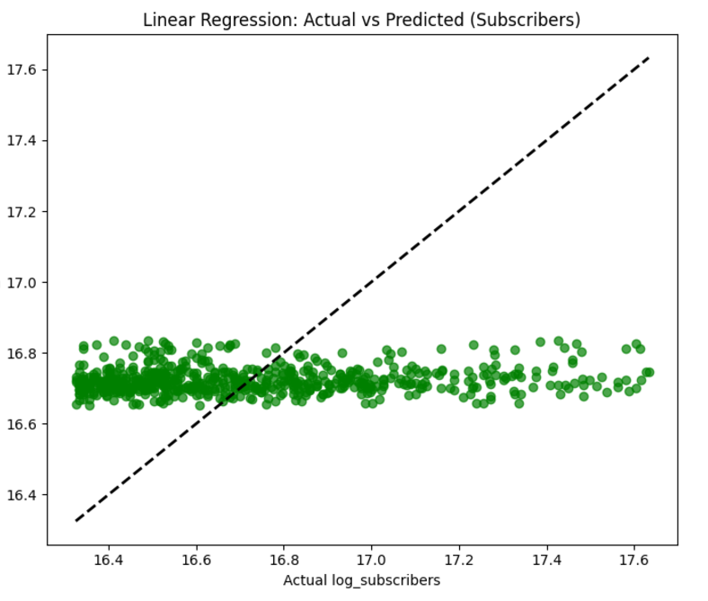
Methodologies – Data Modeling
Linear Regression
Investigates the linear relationship between the log-transformed upload count and two dependent variables: log-transformed video views and log-transformed subscriber counts.
Mean Squared Error (MSE) quantifies the model’s prediction accuracy
Lower MSE values suggest better fit.
The model was effective, likely due to a relatively linear relationship between upload count and the dependent variables.
Takeaway: Graphs show how an increase in upload rates positively impacts viewership, but not so much with subscriber count.
Closer to the "perfect" line means greater relationship

Slide 13
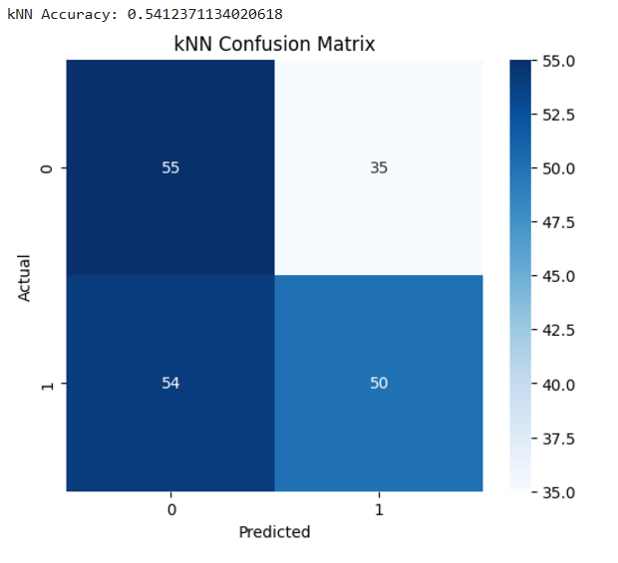
Methodologies – Data Modeling
KNN Model
Classifies channels into two categories based on whether their video views exceed the median value. It uses the upload count as a predictor.
Takeaway: To pair with linear regression in viewership, the kNN model shows that higher uploads also correlate with higher viewership
Actual 0 and Predicted 0: Channels correctly classified as low-view (true negatives).
Actual 1 and Predicted 1: Channels correctly classified as high-view (true positives).
Actual 0, Predicted 1: Channels incorrectly classified as high-view (false positives).
Actual 1, Predicted 0: Channels incorrectly classified as low-view (false negatives).
Thus, there are more false negatives than false positives. Showing that there are more channels that have high-view rates in relation to upload

Slide 14
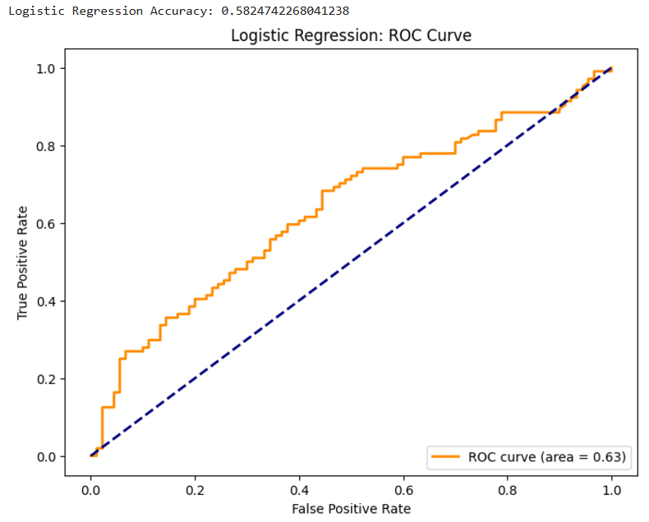
Methodologies – Data Modeling
Logistic Regression
The Area Under the Curve (AUC) score measures overall performance, with values closer to 1 indicating better classification.
Reveals the probability of achieving high video views based on upload count. Higher AUC values mean the model predicts the probability of high video views effectively.
AUC = 0.63
The logistic regression model has moderate strength.
For a randomly chosen channel from the "high-view" group and one from the "low-view" group, the model correctly predicts the "high-view" channel 63% of the time.
Takeaway: Model predicts 63% of the time a channel with have a high view count if it's uploads also increase, showing a moderate correlation.

Slide 15
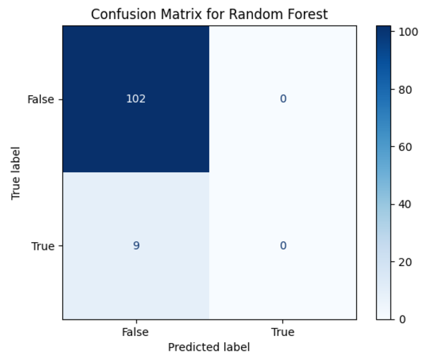
Methodologies – Data Modeling
Random Forest Model
Combines multiple prediction trees into a "forest" to create one big prediction.
The confusion matrix shows how well the model performed in predicting successful and unsuccessful channels.
The model correctly predicted most False (unsuccessful) cases, while it struggled with True (successful) cases due to class imbalance.
As a result, the model achieved 90% accuracy.
Takeaway: The confusion matrix highlights the need for balancing the data to better predict rare cases.

Slide 16
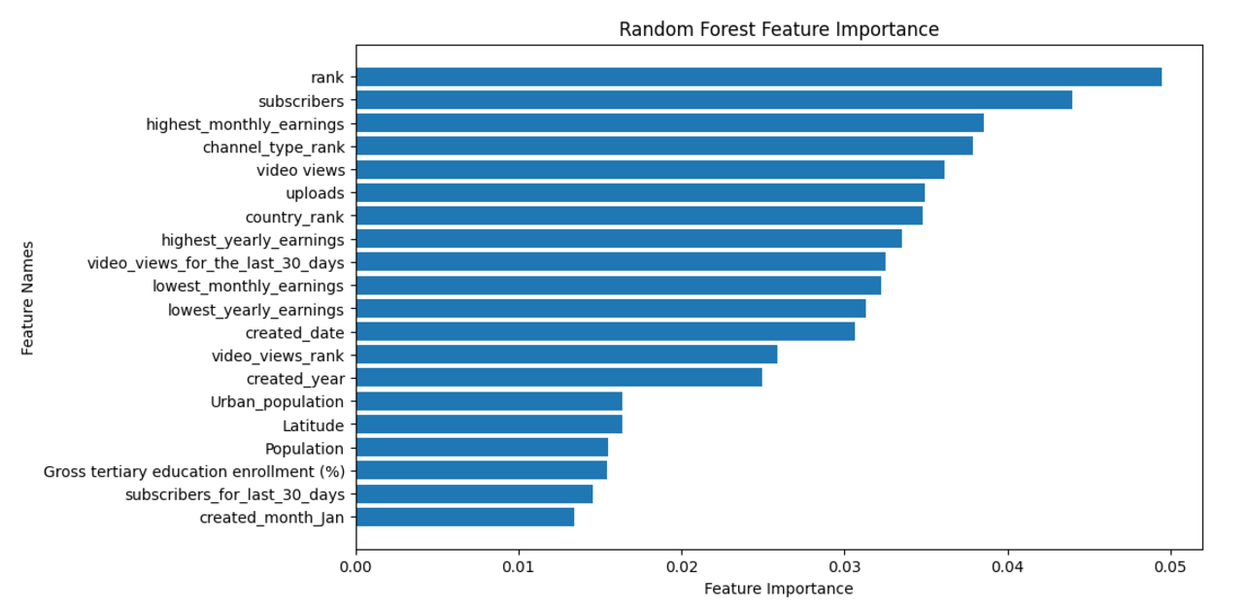
Methodologies – Data Modeling
Feature Importance Graph
The graph shows the top factors that influence YouTube success.
Top 3 features: rank, subscribers, and highest monthly earnings.
Takeaway: This analysis confirms that upload count doesn't play a crucial role in influencing a channel's video views and subscribers, but it still has a small, indirect impact.

Slide 17
Results and Conclusion
Our data and visualizations show...
The strengths of different models:
Linear Regression: Good for identifying trends and relationships between numerical features.
kNN: Effective for capturing non-linear patterns but sensitive to noisy data
Logistic Regression: Simple and interpretable for binary classification but struggles with complex patterns
Random Forest: Best overall performance, highlighting the importance of features such as subscribers, rank, and upload frequency.
Our findings suggest that...
YouTube success strategies can be forecasted:
Features like upload frequency, video views, and subscribers strongly influence success.
Random Forest confirms that increasing subscribers and maintaining consistent uploads are key drivers
Upload count does not significantly influence a channel's video views count and subscriber count, but there is a positive relationship.

